Slide 1
Title Search
Cycle 1
Brandon Toups
Justin Greenfield
Mina Narayanan
Jay Patel
AJ Hancher

Slide 3
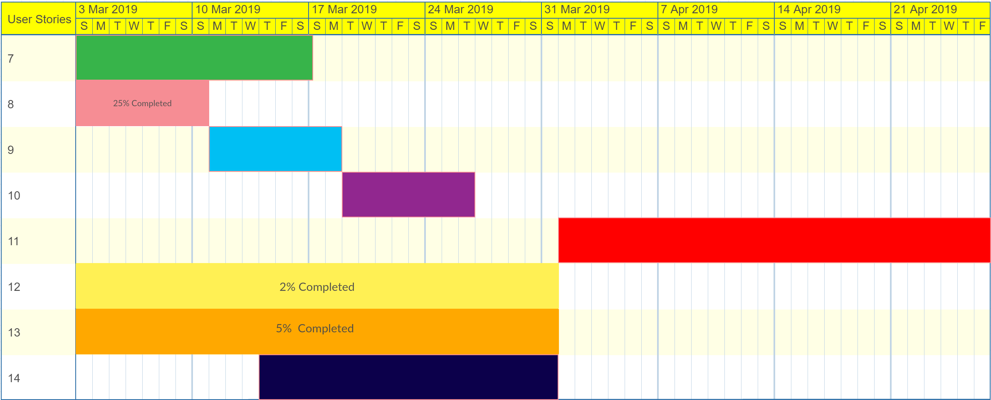
Cycle Progress
Notes:
AJ

Slide 4
Design Discussion
Decoupled design
OOP
Creating multiple classes and managers
Title Searcher Class
Warranty Deed Class
Warranty Deed Manager
Trust Deed Class
Trust Deed Manager
Database Manager
Title Searcher Manager
Perform Title Search Servlet
Notes:
OOP: Mina
Title Searcher Class: Mina
Warranty Deed Class: Justin
Warranty Deed Manager: Justin
Trust Deed Class: Brandon
Trust Deed Manager: Brandon
Database Manager: AJ
Title Searcher Manager: Jay
Perform Title Search Servlet: Jay

Slide 5
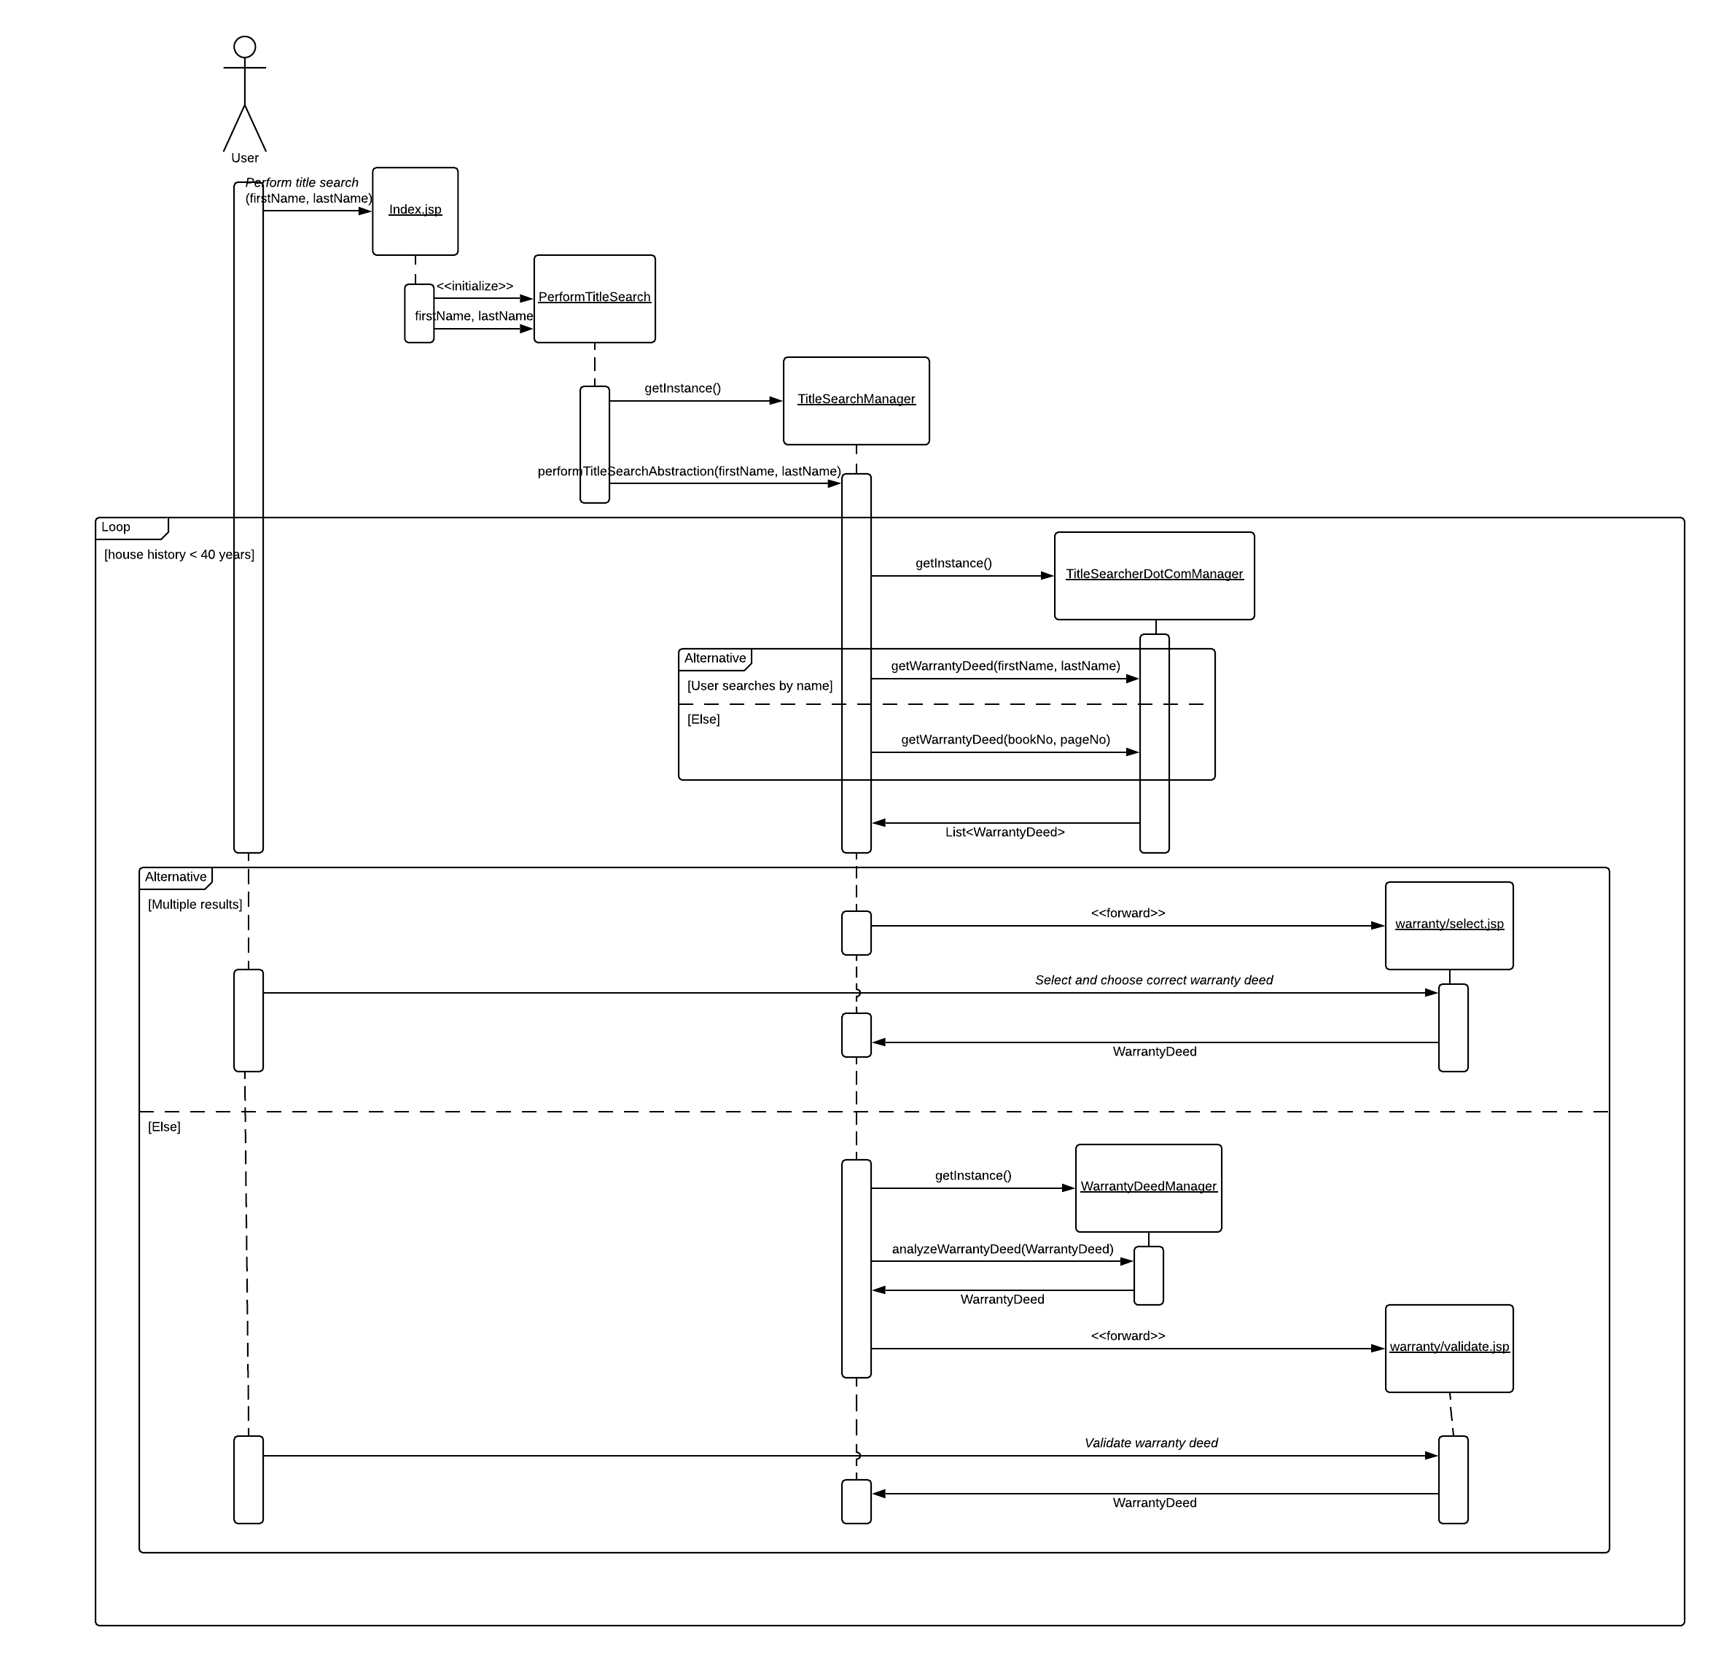
TitleSearchManager
Sequence
Diagram
Notes:
Jay

Slide 6
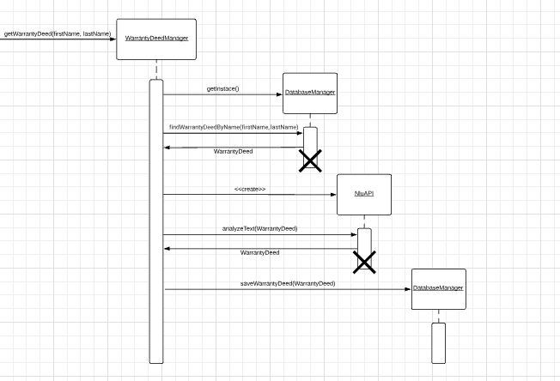
WarrantyDeedManager Sequence Diagram
Notes:
Justin

Slide 7
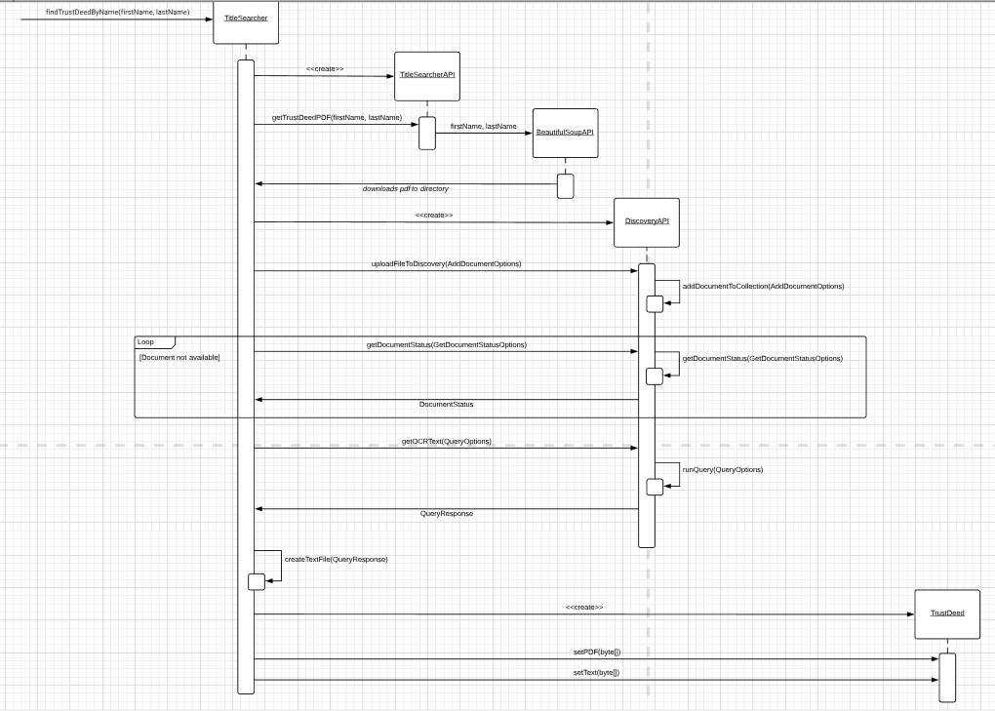
TitleSearchComManager Sequence Diagram
Notes:
Jay

Slide 8
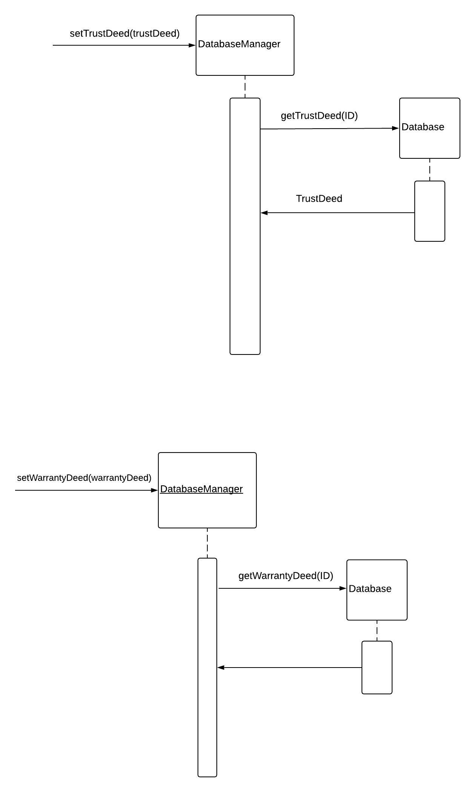
Database Manager Sequence Diagrams
Notes:
AJ

Slide 9
Process Discussion
Discord for remote meetings and development chat
GroupMe for informal chat
Consolidation
Various repos and branches -> monorepo
Trello for integration
Eclipse
Document gathering process
Notes:
Brandon

Slide 10
Lessons Learned
Team communication
Communication with our sponsor
Large learning curve
Cloud native application
Cutting edge (Discovery/Natural Language Understanding/ WKS)
Lawyer jargon
No document standardization
Notes:
Mina

Slide 11
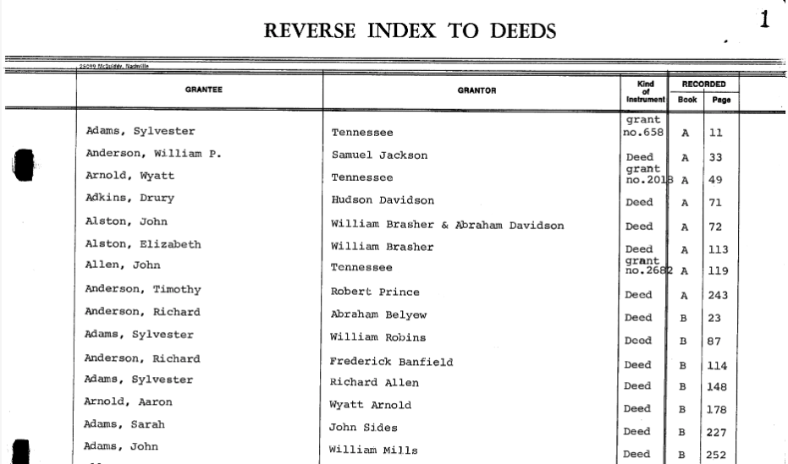
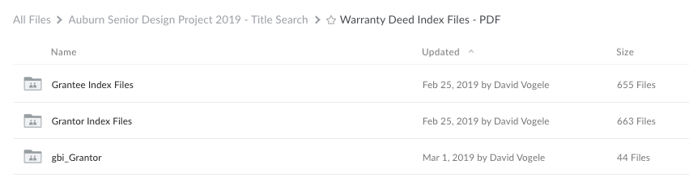
Future Plans
(Indexing)
Notes:
Mina

Slide 12
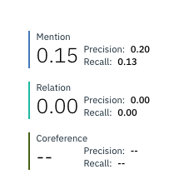
Future Plans - NLU Performance
Training
Current: 20 Deeds
Coming week: 70 deeds
End: >200 Deeds
Notes:
Brandon

Slide 13
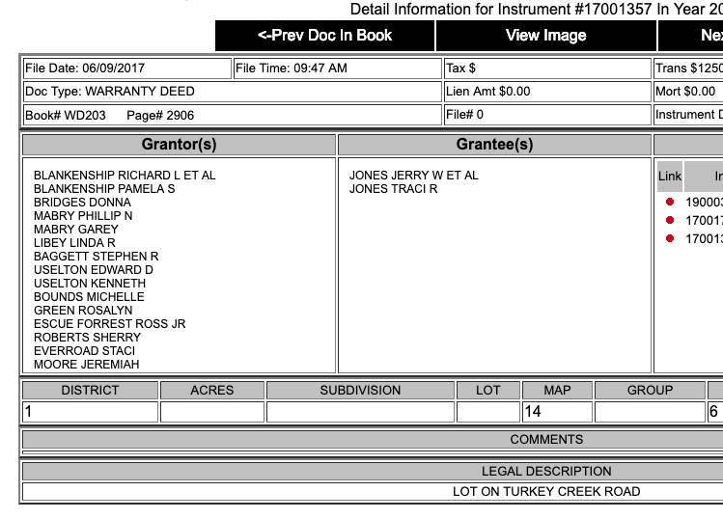
Future Plans
(Ownership)
Current: 1 Grantor / 1 Grantee
Future: List of Grantors / Grantees
Future: Chain of Ownership (Array)
Notes:
Brandon

